Slide 1

Patient Assessment
CHAPTER 10

Slide 2
National EMS Education Standard Competencies (1 of 10)
Assessment
Applies scene information and patient assessment findings (scene size-up, primary and secondary assessment, patient history, and reassessment) to guide emergency management.
Notes:
National EMS Education Standard Competencies
Assessment
Applies scene information and patient assessment findings (scene size-up, primary and secondary assessment, patient history, and reassessment) to guide emergency management.

Slide 3
National EMS Education Standard Competencies (2 of 10)
Scene safety
Scene management
  Impact of the environment on patient care
  Addressing hazards
  Violence
Notes:
National EMS Education Standard Competencies
Scene Size-up
• Scene safety
• Scene management
Impact of the environment on patient care
Addressing hazards
Violence

Slide 4
National EMS Education Standard Competencies (3 of 10)
Scene management (cont’d)
  Need for additional or specialized resources
  Standard precautions
  Multiple-patient situations
Notes:
National EMS Education Standard Competencies
• Scene management (cont’d)
Need for additional or specialized resources
Standard precautions
Multiple-patient situations

Slide 5
National EMS Education Standard Competencies (4 of 10)
Primary Assessment
Primary assessment for all patient situations
  Level of consciousness
  ABCs
  Identifying life threats
  Assessment of vital functions
  Initial general impression
Notes:
National EMS Education Standard Competencies
Primary Assessment
• Primary assessment for all patient situations
Level of consciousness
ABCs
Identifying life threats
Assessment of vital functions
Initial general impression

Slide 6
National EMS Education Standard Competencies (5 of 10)
Primary Assessment (cont’d)
Begin interventions needed to preserve life
Integration of treatment/procedures needed to preserve life
Notes:
National EMS Education Standard Competencies
• Begin interventions needed to preserve life
• Integration of treatment/procedures needed to preserve life

Slide 7
National EMS Education Standard Competencies (6 of 10)
History Taking
Determining the chief complaint
Mechanism of injury/nature of illness
Associated signs and symptoms
Investigation of the chief complaint
Past medical history
Pertinent negatives
Notes:
National EMS Education Standard Competencies
History Taking
• Determining the chief complaint
• Mechanism of injury/nature of illness
• Associated signs and symptoms
• Investigation of the chief complaint
• Past medical history
• Pertinent negatives

Slide 8
National EMS Education Standard Competencies (7 of 10)
Secondary Assessment
Performing a rapid full-body scan
Focused assessment of pain
Assessment of vital signs
Techniques of physical examination
  Respiratory system
    Presence of breath sounds
Notes:
National EMS Education Standard Competencies
Secondary Assessment
• Performing a rapid full-body scan
• Focused assessment of pain
• Assessment of vital signs
• Techniques of physical examination
Respiratory system
Presence of breath sounds

Slide 9
National EMS Education Standard Competencies (8 of 10)
Secondary Assessment (cont’d)
Techniques of physical examination (cont’d)
  Cardiovascular system
  Neurologic system
  Musculoskeletal system
  All anatomic regions
Notes:
National EMS Education Standard Competencies
Cardiovascular system
Neurologic system
Musculoskeletal system
All anatomic regions

Slide 10
National EMS Education Standard Competencies (9 of 10)
Monitoring Devices
Obtaining and using information from patient monitoring devices including (but not limited to):
  Pulse oximetry
  Noninvasive blood pressure
Notes:
National EMS Education Standard Competencies
Monitoring Devices
• Obtaining and using information from patient monitoring devices including (but not limited to)
Pulse oximetry
Noninvasive blood pressure

Slide 11
National EMS Education Standard Competencies (10 of 10)
Reassessment
How and when to reassess patients
How and when to perform a reassessment for all patient situations
Notes:
National EMS Education Standard Competencies
Reassessment
• How and when to reassess patients
• How and when to perform a reassessment for all patient situations

Slide 12
Introduction (1 of 3)
Patient assessment is very important.
EMTs must master the patient assessment process.
Patient assessment is used, to some degree, in every patient encounter.
Notes:
Lecture Outline
I. Introduction
A. The importance of patient assessment cannot be overemphasized.

Slide 13
Introduction (2 of 3)
Five main parts:
  Scene size-up
  Primary assessment
  History taking
  Secondary assessment
  Reassessment
Notes:
Lecture Outline
B. The assessment process is divided into five main parts:
1. Scene size-up
2. Primary assessment
3. History taking
4. Secondary assessment
5. Reassessment
a. The order in which the steps are performed depends on the patient’s condition and the environment in which the patient is found.
b. It be may necessary to change the order of some of the steps after scene size-up based on your findings and the need to prioritize the care of certain conditions.

Slide 14
Introduction (3 of 3)
Rarely does one sign or symptom show you the patient’s status or underlying problem.
  Symptom: subjective condition the patient feels and tells you about
  Sign: objective condition you can observe about the patient
Notes:
Lecture Outline
C. Rarely does one sign or symptom show you the patient’s status or underlying problem.
1. A symptom is a subjective condition the patient feels and tells you about.
2. A sign is an objective condition you can observe or measure about the patient.

Slide 15
Scene Size-up
Your evaluation of the conditions in which you will be operating
Maintain situational awareness.
Scene size-up combines:
  An understanding of the situation and conditions prior to responding
  Dispatcher’s basic information
  Observation of the scene
Notes:
Lecture Outline
II. Scene Size-up
A. The scene size-up refers to your evaluation of the conditions in which you will be operating.
1. Situational awareness is necessary throughout the entire call to ensure safety.
2. Dispatch provides basic information about the request for assistance.
a. Scene size-up combines information and observations to help ensure safe and effective operations.
i. An understanding of the situation and conditions prior to responding
ii. The dispatcher’s information
iii. An observation of the scene

Slide 16
Ensure Scene Safety (1 of 3)
Issues can range from minor difficulties to major dangers.
Do not enter until the scene is safe for you and your team.
Typically, the way you enter an area is the way you will leave.
Wear a high-visibility safety vest on roadways.
Notes:
Lecture Outline
B. Ensure scene safety.
1. Issues that you may encounter in the prehospital setting can range from minor difficulties to major dangers.
2. If a scene is not safe for you and your team to enter the scene and approach and manage the patient, do what you can to make it safe or call for additional resources.
3. Consider traffic safety issues and issues related to scene safety if you must approach a patient on a working roadway.

Slide 17
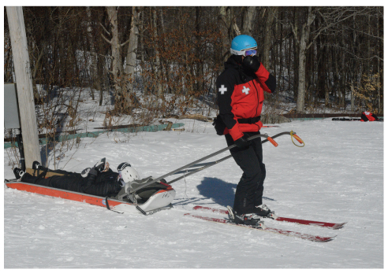
Ensure Scene Safety (2 of 3)
Consider difficult terrain.
Consider traffic safety issues.
Consider environmental conditions.
FIGURE 10-1 At times, you may need to move patients out of areas with difficult terrain.
Courtesy of the National Ski Patrol.
Notes:
Lecture Outline
4. Consider environmental conditions at the scene.

Slide 18
Ensure Scene Safety (3 of 3)
If appropriate, help protect bystanders from becoming patients.
Hazards range from extreme weather conditions to the threat of physical violence.
An emergency scene is a dynamically changing environment.
Notes:
Lecture Outline
5. If appropriate, help protect bystanders from becoming patients as well.
6. Some forms of hazards:
a. Environmental
b. Physical (sharp metal, broken glass, slip-and-fall hazards)
c. Chemical (hazardous materials)
d. Electrical
e. Water
f. Fire
g. Explosions
h. Physical violence
7. Be aware of scenes that have the potential for violence.
a. Violent patients
b. Distraught family members
c. Angry bystanders
d. Gangs
e. Unruly crowds
8. An emergency scene is a dynamically changing environment.

Slide 19
Determine Mechanism of Injury/Nature of Illness (1 of 5)
Calls for assistance can be categorized as medical conditions, traumatic injuries, or both.
Mechanism of injury (MOI)
  Type or amount of force
  How long it was applied
  Where it was applied to the body
Notes:
Lecture Outline
C. Determine mechanism of injury (MOI)/nature of illness (NOI).
1. Calls for assistance to which you may respond can be categorized as medical conditions, traumatic injuries, or both.
2. Traumatic injuries are the result of physical forces applied to the outside of the body, usually from an object striking the body or the body striking an object.

Slide 20
Determine Mechanism of Injury/Nature of Illness (2 of 5)
Blunt trauma
  The force occurs over a broad area.
  Skin is usually not broken.
  Tissues and organs below the area of impact may be damaged.
Notes:
Lecture Outline
3. For patients who have experienced traumatic injuries, determine the mechanism of injury (MOI).
a. Terms commonly associated with MOI include blunt trauma and penetrating trauma.

Slide 21
Determine Mechanism of Injury/Nature of Illness (3 of 5)
Penetrating trauma
  The force of the injury occurs at a small point of contact between the skin and the object.
  Open wound with high potential for infection
Notes:
Lecture Outline
3. For patients who have experienced traumatic injuries, determine the mechanism of injury (MOI).
a. Terms commonly associated with MOI include blunt trauma and penetrating trauma.

Slide 22
Determine Mechanism of Injury/Nature of Illness (4 of 5)
For medical patients, determine the nature of illness (NOI).
Similarities between MOI and NOI
Talk with the patient, family, or bystanders.
Use your senses to check for clues.
Notes:
Lecture Outline
4. For medical patients, determine the nature of illness (NOI).

Slide 23
Determine Mechanism of Injury/Nature of Illness (5 of 5)
Be aware of scenes with more than one patient with similar signs or symptoms.
  Example: carbon monoxide poisoning
  Could indicate an unsafe scene for the EMT as well
Notes:
Lecture Outline
5. Be aware of scenes with multiple patients who are exhibiting similar signs or symptoms.

Slide 24
Importance of MOI and NOI
Considering the MOI or NOI early can be of value in preparing to care for the patient.
You may be tempted to categorize the patient immediately as either trauma or medical.
Notes:
Lecture Outline
D. The importance of the MOI and NOI
1. Considering the MOI or NOI early can be of value in preparing to care for your patient.

Slide 25
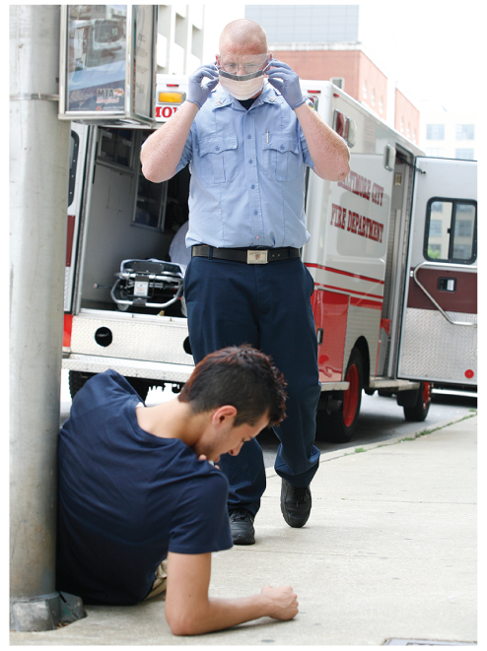
Take Standard Precautions (1 of 3)
Wear personal protective equipment (PPE).
  Should be adapted to the prehospital task at hand
FIGURE 10-4 Proper protective equipment is vital when
you are called to a scene in which you may be exposed to
infection or blood or other body fluids.
© Jones & Bartlett Learning. Courtesy of MIEMSS
Notes:
Lecture Outline
E. Take standard precautions
1. Standard precautions and personal protective equipment (PPE) need to be considered and adapted to the prehospital task at hand.

Slide 26
Take Standard Precautions (2 of 3)
Standard precautions have been recommended for use in dealing with:
  Objects
  Blood
  Body fluids
  Other potential exposure risks of communicable disease
Notes:
Lecture Outline
2. Standard precautions are protective measures that have traditionally been recommended by the Centers for Disease Control and Prevention for use in dealing with:
a. Objects
b. Blood
c. Body fluids
d. Other potential exposure risks of communicable disease

Slide 27
Take Standard Precautions (3 of 3)
When you step out of the EMS vehicle, standard precautions must have been already taken or initiated.
  At a minimum, gloves must be in place.
  Consider glasses and a mask.
Notes:
Lecture Outline
3. The concept of standard precautions assumes that all blood, body fluids (except sweat), nonintact skin, and mucous membranes may pose a substantial risk of infection.
4. When you step out of the EMS vehicle and before actual patient contact, standard precautions must have been taken or initiated.
a. At a minimum, gloves must be in place before any patient contact.
b. Also consider glasses and a mask.

Slide 28
Determine Number of Patients (1 of 2)
During scene size-up, accurately identify the total number of patients.
  Critical in determining the need for additional resources
When there are multiple patients, use the incident command system, identify the number of patients, and then begin triage.
Notes:
Lecture Outline
F. Determine number of patients.
1. During scene size-up, it is important to accurately identify the total number of patients.
2. When there are multiple patients, you should use the incident command system, identify the number of patients, and then begin triage.

Slide 29
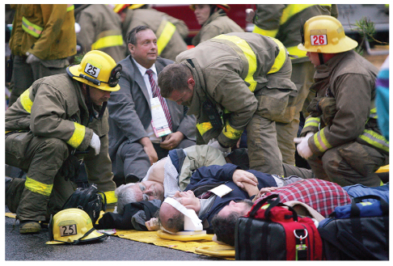
Determine Number of Patients (2 of 2)
Triage is the process of sorting patients based on the severity of each patient’s condition.
FIGURE 10-5 With multiple patients, use the incident
command system, call for additional resources, and then
begin triage. A multiple casualty incident involving two
trains that collided in 2005.
© David McNew/Getty Images News/Getty Images.
Notes:
Lecture Outline
a. Triage is the process of sorting patients based on the severity of each patient’s condition.

Slide 30
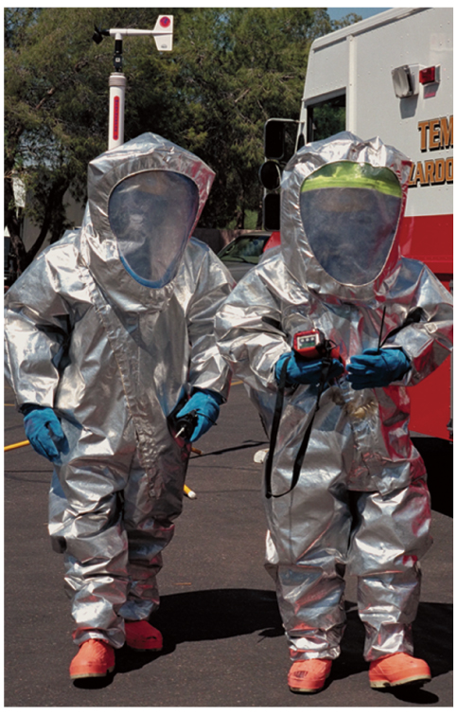
Consider Additional/Specialized Resources (1 of 3)
Some situations may require:
  More ambulances
  Specialized resources
FIGURE 10-6 Scenes involving toxic substances may require specially trained rescuers with extra protective equipment.
Courtesy of Tempe Fire Department.
Notes:
Lecture Outline
G. Consider additional/specialized resources.

Slide 31
Consider Additional/Specialized Resources (2 of 3)
Specialized resources include:
  Advanced life support (ALS)
  Air medical support
  Fire departments, who may handle high-angle rescue, hazardous materials, or water rescue
  Law enforcement
Notes:
Lecture Outline
1. Specialized resources include:
a. Advanced life support (ALS)
b. Air medical support
c. Fire departments may handle hazardous materials management, technical rescue services including complex extrication from motor vehicle crashes, wilderness search and rescue, high-angle rope rescue, or water rescue.
d. Law enforcement personnel

Slide 32
Consider Additional/Specialized Resources (3 of 3)
To determine if you require additional resources, ask yourself:
  Does the scene pose a threat to me, my patient, or others?
  How many patients are there?
  Do we have the resources to respond to their conditions?
Notes:
Lecture Outline
Questions to ask when determining the need for additional resources:
a. Does the scene pose a threat to you, your patient, or others?
b. How many patients are there?
c. Do we have the resources to respond to their conditions?

Slide 33
Primary Assessment
Begins when you greet your patient
The goal is to identify and initiate treatment of immediate or potential life threats.
Physically examine the patient and assess:
  LOC
  ABCs
Notes:
Lecture Outline
III. Primary Assessment
A. Patient assessment begins when you greet your patient.
1. The single, all-important goal of the primary assessment is to identify and begin treatment of immediate or imminent life threats.
2. You must physically examine the patient and assess level of consciousness (LOC) and airway, breathing, and circulation (ABCs).

Slide 34
Form a General Impression (1 of 3)
Formed to determine the priority of care
First part of primary assessment
Make a note of the person’s:
  Age, sex, and race
  Level of distress
  Overall appearance
Notes:
Lecture Outline
B. Form a general impression.
1. Formed to determine the priority of care and is the first part of your primary assessment.
2. Includes making a note of the person’s:
a. Age
b. Sex
c. Race
d. Level of distress
e. Overall appearance

Slide 35
Form a General Impression (2 of 3)
Note the patient’s position.
Avoid standing over the patient.
Address the patient by name.
Introduce yourself.
Ask about the chief complaint.
Address life-threats immediately.
Notes:
Lecture Outline
3. As you approach, make sure the patient sees you coming.
a. Note the patient’s position and whether the patient is moving or still.
b. Avoid standing over the patient, if possible.
c. Address the patient by name.
d. Introduce yourself to the patient.
e. Ask about the chief complaint.
f. The patient’s response can give insight into the LOC, air patency, respiratory status, and overall circulatory status.
g. Life-threatening problems should be treated immediately.
4. Define whether your patient’s condition is stable, stable but potentially unstable, or unstable to direct further assessment and treatment.

Slide 36
Form a General Impression (3 of 3)
Determine if the patient’s condition is:
  Stable
  Stable but potentially unstable
  Unstable
Notes:
Lecture Outline
4. Define whether your patient’s condition is stable, stable but potentially unstable, or unstable to direct further assessment and treatment.

Slide 37
Scan for Signs of Uncontrolled Bleeding
Uncontrolled external bleeding takes priority over other assessments.
Notes:
Lecture Outline
C. Scan for signs of uncontrolled external bleeding
1. Uncontrolled external bleeding takes priority over other assessments.

Slide 38
Assess Level of Consciousness (1 of 7)
The level of consciousness (LOC) can tell you a great deal about the patient’s neurologic and physiologic status.
Notes:
Lecture Outline
D. Assess level of consciousness (LOC).
1. The LOC can tell you a great deal about the patient’s neurologic and physiologic status.

Slide 39
Assess Level of Consciousness (2 of 7)
Assessment of an unconscious patient focuses on airway, breathing, and circulation.
  Sustained unconsciousness should warn you of a critical respiratory, circulatory, or central nervous system problem.
Notes:
Lecture Outline
2. Assessment of an unconscious patient focuses first on airway, breathing, and circulation (ABCs).
a. Sustained unconsciousness should warn you that a critical respiratory, circulatory, or central nervous system problem or deficit might exist.

Slide 40
Assess Level of Consciousness (3 of 7)
Conscious with an altered LOC may be due to inadequate perfusion.
Could also be caused by medications, drugs, alcohol, or poisoning
Notes:
Lecture Outline
3. Conscious with an altered LOC may be due to inadequate perfusion, medications, drugs, alcohol, or poisoning

Slide 41
Assess Level of Consciousness (4 of 7)
To assess for responsiveness, use the mnemonic AVPU:
  Awake and alert
  Responsive to Verbal stimuli
  Responsive to Pain
  Unresponsive
Notes:
Lecture Outline
4. To assess for responsiveness, use the mnemonic AVPU, and choose one description:

Slide 42
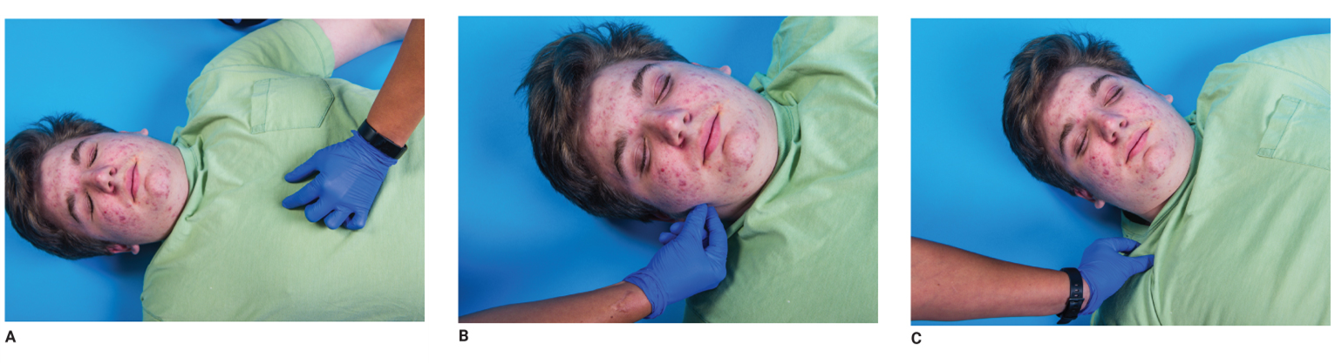
Assess Level of Consciousness (5 of 7)
Test responsiveness to painful stimuli.
FIGURE 10-9 Methods of gauging a patient’s responsiveness to painful stimuli. A. Gently but firmly pinch the patient’s ear lobe. B. Press on the bone above the eye. C. Gently but firmly pinch the muscles of the neck.
© Jones & Bartlett Leaning.
Notes:
Lecture Outline
5. Stimulus tests determine whether a patient who does not respond to verbal stimuli will respond to a painful stimulus. These tests include:
a. Pinching the patient’s skin
i. Back of the upper arm
ii. Trapezius area
b. Applying upward pressure along the ridge of the orbital rim along the underside of the eyebrow
c. A patient who moans or withdraws is responding to the stimulus

Slide 43
Assess Level of Consciousness (6 of 7)
Orientation tests mental status.
Evaluates a patient’s ability to remember:
  Person
  Place
  Time
  Event
Notes:
Lecture Outline
6. Orientation tests mental status by checking a patient’s memory and thinking ability.
a. Evaluates a patient’s ability to remember:
i. Person—remembers his or her name
ii. Place—identifies the current location
iii. Time—the current year, month, and approximate date
iv. Event—describes what happened

Slide 44
Assess Level of Consciousness (7 of 7)
Evaluates long-term memory, intermediate-term memory, and short-term memory
Altered mental status
  Any deviation from alert and oriented to person, place, time, and event
  Any deviation from the patient’s normal baseline
Notes:
Lecture Outline
b. Any deviation from alert and oriented to person, place, time, and event, or from a patient’s normal baseline, is considered an altered mental status.

Slide 45
Identify and Treat Life-Threats (1 of 2)
Conditions that cause sudden death:
  Airway obstruction
  Respiratory failure
  Respiratory arrest
  Shock
  Severe bleeding
  Primary cardiac arrest
Notes:
Lecture Outline
D. Identify and treat life threats
1. Conditions that cause sudden death:
a. Airway obstruction
b. Respiratory failure
c. Respiratory arrest
d. Shock
e. Severe bleeding
f. Primary cardiac arrest

Slide 46
Identify and Treat Life-Threats (2 of 2)
In most cases, begin with airway, followed by breathing and circulation (ABC).
In some cases, it may be appropriate to address life threats to circulation first (CAB).
Notes:
Lecture Outline
2. In most cases, identifying and correcting life-threatening issues begins with the airway, followed by breathing and circulation (ABC).
a. In some cases, it is more appropriate to address life threats to circulation first, following a sequence of circulation, airway, and breathing (CAB).

Slide 47
Assess the Airway (1 of 4)
Moving through the primary assessment, stay alert for signs of airway obstruction.
Ensure the airway remains open (patent) and adequate.
Notes:
Lecture Outline
E. Assess the airway.
1. As you move through the primary assessment, stay alert for signs of airway obstruction.
2. Ensure that the airway remains open (patent) and adequate.

Slide 48
Assess the Airway (2 of 4)
Responsive patients
  Patients who are talking or crying have an open airway.
  Watch and listen to how patients speak.
  If you identify an airway problem, stop the assessment and work to clear the patient’s airway.
Notes:
Lecture Outline
3. Responsive patients
a. Patients of any age who are talking or crying have an open airway.
b. A conscious patient who cannot speak or cry most likely has a severe airway obstruction.
c. If you identify an airway problem, stop the assessment process and work to clear the patient’s airway.
d. If your patient has signs of difficulty breathing or is not breathing, immediately take corrective actions.

Slide 49
Assess the Airway (3 of 4)
Unresponsive patients
  Immediately assess the airway.
  Use the jaw-thrust technique when necessary.
  Use the head tilt–chin lift technique when necessary.
  Relaxation of the tongue muscles is a cause of airway obstruction.
Notes:
Lecture Outline
4. Unresponsive patients
a. Immediately assess the patency of the airway.
b. If there is a potential for trauma, use the jaw-thrust maneuver to open the airway.
c. If you cannot obtain a patent airway using the jaw-thrust maneuver or if it can be confirmed that the patient did not experience a traumatic event, use the head tilt–chin lift maneuver to open and maintain a patent airway.

Slide 50
Assess the Airway (4 of 4)
Signs of obstruction in an unconscious patient:
  Obvious trauma, blood, or obstruction
  Noisy breathing (snoring, bubbling, gurgling, crowing, abnormal sounds)
  Extremely shallow or absent breathing
Notes:
Lecture Outline
5. Signs of obstruction in an unconscious patient:
a. Obvious trauma, blood, or other obstruction
b. Noisy breathing, such as snoring, bubbling, gurgling, crowing, stridor, or other abnormal sounds
c. Extremely shallow or absent breathing

Slide 51
Assess Breathing (1 of 5)
Make sure the patient’s airway is open.
Make sure the patient’s breathing is present and adequate.
Ask yourself:
  Is the patient breathing?
  Is the patient breathing adequately?
  Is the patient hypoxic?
Notes:
Lecture Outline
E. Assess breathing.
1. Once you have made sure the patient’s airway is open, make sure the patient’s breathing is present and adequate.
2. As you assess the patient’s breathing, ask the following questions:
a. Is the patient breathing?
b. Is the patient breathing adequately?
c. Is the patient hypoxic?

Slide 52
Assess Breathing (2 of 5)
Consider providing positive pressure ventilations with an airway adjunct when:
  Respirations exceed 28 breaths/min
  Respirations are fewer than 8 breaths/min
The goal for oxygenation for most patients is an oxygen saturation of approximately 94% to 99%.
Notes:
Lecture Outline
3. Positive pressure ventilations should be performed for patients who are not breathing or whose breathing is too slow or too shallow.
4. If the patient is breathing adequately but remains hypoxic, administer oxygen.
a. The goal for oxygenation for most patients is an oxygen saturation of approximately 94% to 99%.
5. If a patient seems to develop difficulty breathing after your primary assessment, you should immediately reevaluate the airway.
a. Consider providing positive pressure ventilations with an airway adjunct when:
i. Respirations exceed 28 breaths/min
ii. Respirations are fewer than 8 breaths/min
iii. Respirations too shallow to provide adequate air exchange
6. Shallow respirations can be identified by little movement of the chest wall (reduced tidal volume) or poor chest excursion.

Slide 53
Assess Breathing (3 of 5)
Observe how much effort is required for the patient to breathe:
  Retractions
  Use of accessory muscles
  Nasal flaring
  Two- to three-word dyspnea
  Tripod position
  Sniffing position
  Labored breathing
Notes:
Lecture Outline
7. Observe how much effort is required for the patient to breathe.
a. Presence of retractions
b. Use of accessory muscles
c. Nasal flaring
d. Two- to three-word dyspnea
e. Tripod position
f. Sniffing position
g. Labored breathing

Slide 54
Assess Breathing (4 of 5)
Respiratory distress
  Increased work of breathing
  Increased effort and rate
Notes:
Lecture Outline
8. Respiratory distress
a. Increased effort and rate

Slide 55
Assess Breathing (5 of 5)
Respiratory failure
  Occurs when the blood is inadequately oxygenated, or ventilation is inadequate to meeting the oxygen demands of the body
  The ultimate result of respiratory failure if it is not corrected
Notes:
Lecture Outline
9. Respiratory failure
a. Occurs when the blood is inadequately oxygenated, or ventilation is inadequate to meet the oxygen demands of the body.
b. The ultimate result of respiratory failure if it is not corrected.

Slide 56
Assess Circulation (1 of 11)
Assess
  Mental status
  Pulse
  Skin condition
Notes:
Lecture Outline
F. Assess circulation.
1. Evaluated by assessing the patient’s mental status, pulse, and skin condition.

Slide 57
Assess Circulation (2 of 11)
Assess pulse
  The pulse is the pressure wave that occurs as each heartbeat causes a surge in the blood circulating through the arteries.
  Palpate (feel) the pulse.
  If you cannot palpate a pulse in an unresponsive patient, begin CPR.
Notes:
Lecture Outline
2. Assess pulse.
a. To determine if a pulse is present, you will need to palpate the pulse.
i. In responsive patients who are older than 1 year, you should palpate the radial pulse at the wrist.
ii. In unresponsive patients older than 1 year, you should palpate the carotid pulse in the neck.
iii. Palpate the brachial pulse, located at the medial area (inside) of the upper arm, in children younger than 1 year.
b. If you cannot palpate a pulse in an unresponsive patient, begin CPR.

Slide 58
Assess Circulation (3 of 11)
Skin condition
  Evaluate the patient’s skin color, temperature, moisture, and capillary refill.
  A normally functioning circulatory system perfuses the skin with oxygenated blood.
Notes:
Lecture Outline
3. Skin condition
a. Perfusion is assessed by evaluating a patient’s skin color, temperature, moisture, and capillary refill.

Slide 59
Assess Circulation (4 of 11)
Skin color
  Determined by the blood circulating through vessels and the amount and type of pigment present in the skin
  Poor circulation will cause the skin to appear pale, white, ashen, or gray.
Notes:
Lecture Outline
b. Skin color
i. Poor peripheral circulation will cause the skin to appear pale, white, ashen, or gray.
ii. High blood pressure may cause the skin to be abnormally flushed and red.
iii. When the blood is not properly saturated with oxygen, it appears blue.

Slide 60
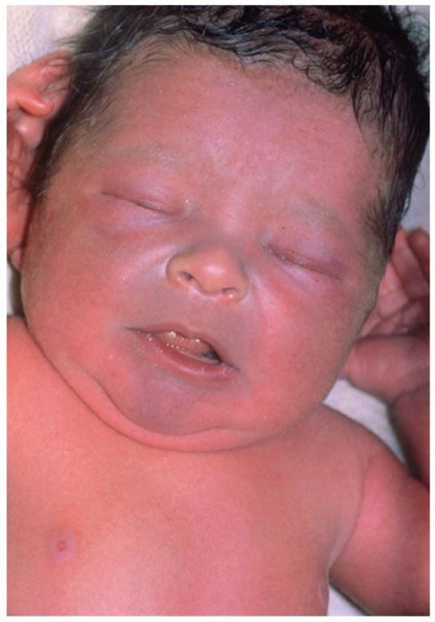
Assess Circulation (5 of 11)
Skin color (cont’d)
  When blood is not properly saturated with oxygen, it appears blue.
  Changes in skin color may result from chronic illness.
FIGURE 10-13 Cyanosis occurs when the patient has low levels of oxygen in the blood.
© St. Bartholomew’s Hospital, London/Photo Researchers, Inc.
Notes:
Lecture Outline
b. Skin color
i. Poor peripheral circulation will cause the skin to appear pale, white, ashen, or gray.
ii. High blood pressure may cause the skin to be abnormally flushed and red.
iii. When the blood is not properly saturated with oxygen, it appears blue.

Slide 61
Assess Circulation (6 of 11)
Skin temperature
  Normal skin will be warm to the touch.
  Abnormal skin temperatures are hot, cool, cold, and clammy.
Notes:
Lecture Outline
c. Skin temperature
i. Normal skin temperature will be warm to the touch.
ii. Abnormal skin temperatures are hot, cool, cold, and clammy.

Slide 62
Assess Circulation (7 of 11)
Skin moisture
  Dry skin is normal.
  Skin that is wet, moist, or excessively dry and hot suggests a problem.
Notes:
Lecture Outline
d. Skin moisture
i. Dry skin is normal.
ii. Skin that is wet, moist, or excessively dry and hot suggests a problem.

Slide 63
Assess Circulation (8 of 11)
Capillary refill
  Evaluated to assess the ability of the circulatory system to restore blood to the capillary system
  Press on the patient’s fingernail.
  Remove the pressure.
  The nail bed should restore to its normal pink color.
Notes:
Lecture Outline
e. Capillary refill
i. Capillary refill is often evaluated in pediatric patients to assess the ability of the circulatory system to perfuse the capillary system in the fingers and toes.

Slide 64
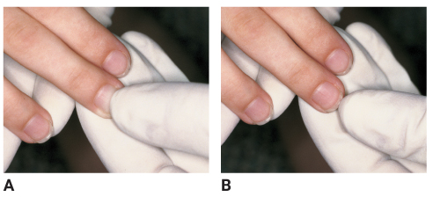
Assess Circulation (9 of 11)
Capillary refill (cont’d)
  Should be restored to normal within 2 seconds
FIGURE 10-14 A. To test capillary refill, gently compress
the fingertip until it blanches. B. Release the fingertip, and
count until it returns to its normal pink color.
A., B: © Jones & Bartlett Learning. Courtesy of MIEMSS.
Notes:
Lecture Outline

Slide 65
Assess Circulation (10 of 11)
Assess and control external bleeding in trauma patients.
  Should occur before addressing airway or breathing concerns.
  Bleeding from a large vein is characterized by a steady flow of blood.
  Bleeding from an artery is characterized by a spurting flow of blood.
Notes:
Lecture Outline
4. Assess and control external bleeding.
a. Should occur before addressing airway or breathing concerns.
b. Bleeding from a large vein is characterized by a steady flow of blood.
c. Bleeding from an artery is characterized by a spurting flow of blood.

Slide 66
Assess Circulation (11 of 11)
Controlling external bleeding can be simple.
  Apply direct pressure.
  Apply a tourniquet if:
    Direct pressure is not quickly successful.
    Obvious arterial hemorrhage of an extremity
Notes:
Lecture Outline
d. Controlling external bleeding is often very simple.
i. Apply direct pressure.
ii. If direct pressure is not quickly successful or if there is an obvious arterial hemorrhage of an extremity, apply a tourniquet.

Slide 67
Perform a Rapid Exam
Identify injuries that must be managed or protected before the patient is transported.
  Take 60 to 90 seconds to perform.
  Not a systematic or focused physical examination
Notes:
Lecture Outline
G. Perform a rapid scan to identify life threats.
1. Identify injuries that must be managed or protected before the patient is transported.
a. Take 60 to 90 seconds to perform the rapid scan.
b. This is not a systematic or focused physical examination.
2. See Skill Drill 10-1.

Slide 68
Determine Priority of Patient Care and Transport (1 of 5)
Primary assessment assists in determining transport priority.
High-priority patients include those with any of the following conditions:
  Unresponsive
  Difficulty breathing
  Uncontrolled bleeding
Notes:
Lecture Outline
H. Determine priority of patient care and transport.
1. High-priority patients include those with any of the following conditions:
a. Unresponsive
b. Difficulty breathing
c. Uncontrolled bleeding

Slide 69
Determine Priority of Patient Care and Transport (2 of 5)
High-priority patients (cont’d):
  Altered level of consciousness
  Severe chest pain
  Pale skin or other signs of poor perfusion
  Complicated childbirth
  Severe pain in any area of the body
Notes:
Lecture Outline
d. Altered level of consciousness
e. Severe chest pain
f. Pale skin or other signs of poor perfusion
g. Complicated childbirth
h. Severe pain in any area of the body

Slide 70
Determine Priority of Patient Care and Transport (3 of 5)
The Golden Hour (Golden Period) is the time from injury to definitive care.
  Treatment of shock and traumatic injuries must occur.
  Immediate transport is one of the keys to survival of patients who need immediate care that the EMT cannot provide.
Notes:
Lecture Outline
2. The Golden Hour (Golden Period) is the time from injury to definitive care, during which treatment of shock and traumatic injuries must occur in order to maximize the patient’s chance of survival.
a. Immediate transport is one of the keys to survival of patients who need immediate care that the EMT cannot provide.

Slide 71
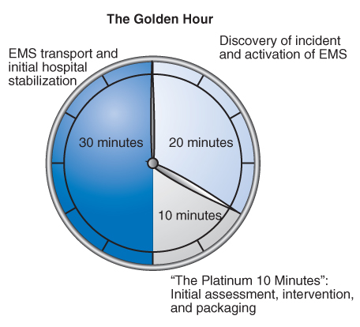
Determine Priority of Patient Care and Transport (4 of 5)
FIGURE 10-16 The Golden Hour, also called the Golden Period, is the time during which treatment of shock or traumatic injuries is most critical and the potential for survival is best.
© Jones & Bartlett Learning.
Notes:
The illustration on this slide represents the Golden Hour or the Golden Period.

Slide 72
Determine Priority of Patient Care and Transport (5 of 5)
Transport decisions should be made at this point, based on:
  Patient’s condition
  Availability of advanced care
  Distance of transport
  Local protocols
Notes:
Lecture Outline
3. Transport decisions should be made at this point.
a. Transport decisions are based on:
i. Patient’s condition
ii. Availability of advanced care
iii. Distance of transport
iv. Local protocols

Slide 73
History Taking (1 of 4)
Provides detail about the chief complaint and the patient’s signs and symptoms
Includes demographic information:
  Date of the incident
  Patient’s age, gender, race, past medical history, and current health status
Notes:
Lecture Outline
IV. History Taking
A. Provides detail about the patient’s chief complaint and an account of the patient’s signs and symptoms.
B. Be sure to document the following information:
1. Date of the incident
2. Patient’s age
3. Patient’s gender
4. Patient’s race
5. Past medical history
6. Patient’s current health status

Slide 74
History Taking (2 of 4)
Investigate the chief complaint.
  Make introductions, make the patient feel comfortable, and obtain permission to treat.
  Ask a few simple and direct questions.
  Refer to the patient as Mr., Ms., or Mrs., using the patient’s last name.
  Ask open-ended questions.
Notes:
Lecture Outline
C. Investigate the chief complaint (history of present illness).
1. Begin by making introductions, make the patient feel comfortable, and obtain permission to treat.
a. Ask a few simple and direct questions.
b. Refer to the patient as Mr., Ms., or Mrs., using the patient’s last name.
c. Open-ended questions will help determine the chief complaint.
d. Use eye contact to encourage the patient to continue speaking and repeat statements back to show understanding.

Slide 75
History Taking (3 of 4)
If the patient is unresponsive, patient information and clues about the incident may be obtained from:
  Family members present
  A person who may have witnessed the situation
  Bystanders
  Medical alert jewelry
  Other patient medical history documentation
Notes:
Lecture Outline
2. If the patient is unresponsive, information about the patient, pertinent past medical history, and clues about the immediate incident may be obtained from:
a. Family members present
b. A person who may have witnessed the situation
c. Bystanders
d. Medical alert jewelry
e. Other patient medical history documentation

Slide 76
History Taking (4 of 4)
Use the OPQRST mnemonic to assess symptoms.
  Onset
  Provocation or palliation
  Quality
  Region/radiation
  Severity
  Timing
Identify pertinent negatives.
Notes:
Lecture Outline
3. Use the OPQRST mnemonic for gathering additional information about the patient’s present illness and current symptoms.
4. Identify pertinent negatives.
a. Pertinent negatives are negative findings that warrant no care or intervention.

Slide 77
Obtain a SAMPLE History
Use the mnemonic SAMPLE to obtain the following information:
  Signs and symptoms
  Allergies
  Medications
  Pertinent past medical history
  Last oral intake
  Events leading up to the injury/illness
Notes:
Lecture Outline
D. Obtain SAMPLE history.

Slide 78
Critical Thinking in Assessment
Gathering
  Seeking facts
Evaluating
  Considering what the information means
Synthesizing
  Putting the information together to plan scene management and patient care
Notes:
Lecture Outline
E. Critical thinking in assessment
1. Critical thinking is an essential component in assessing a patient and involves:
a. Gathering: seeking facts to help your clinical decision making and scene management
b. Evaluating: considering what the information gathered means
c. Synthesizing: putting together the information that you have gathered and validated and synthesizing it into a plan to manage the scene and/or care for the patient.

Slide 79
Taking History on Sensitive Topics (1 of 3)
Alcohol and drugs
  Signs may be confusing, hidden, or disguised.
  Patient may deny having any problems.
  History gathered may be unreliable.
  Do not judge the patient.
  Be professional in your approach.
Notes:
Lecture Outline
F. Taking history on sensitive topics
1. Alcohol and drugs
a. Signs may be confusing, hidden, or disguised.
b. Many patients may deny having any problems.
c. The history gathered from a chemically dependent patient may be unreliable.
d. Do not judge the patient and be professional in your approach.

Slide 80
Taking History on Sensitive Topics (2 of 3)
Physical abuse or violence
  Report all physical abuse or domestic violence to the appropriate authorities.
  Follow local protocols.
  Do not accuse; instead, immediately involve law enforcement.
Notes:
Lecture Outline
2. Physical abuse or violence
a. Report all physical abuse or domestic violence to the appropriate authorities.
b. Follow state laws and local protocols.
c. Do not accuse; instead, immediately involve law enforcement.

Slide 81
Taking History on Sensitive Topics (3 of 3)
Sexual history
  Consider all female patients of childbearing age who report lower abdominal pain to be pregnant.
  Ask about the patient’s last menstrual period.
  Inquire about urinary symptoms with male patients.
  When appropriate, ask all patients about the potential for sexually transmitted diseases.
Notes:
Lecture Outline
3. Sexual history
a. Consider all female patients of childbearing age who report lower abdominal pain to be pregnant unless ruled out by history or other information.
b. Ask about the patient’s last menstrual period.
c. Inquire about urinary symptoms with male patients.
d. When appropriate, ask about the potential for sexually transmitted diseases in all patients.

Slide 82
Special Challenges in Obtaining Patient History (1 of 14)
Silence
  Patience is extremely important.
  Use a closed-ended question that requires a simple yes or no answer.
  Consider whether the silence is a clue to the patient’s chief complaint.
Notes:
Lecture Outline
G. Special challenges in obtaining patient history include:
1. Silence
a. Patience is extremely important when dealing with patients and their emergency crises.
b. Using a closed-ended question that requires a simple yes or no answer may work best.
c. Consider whether the silence is a clue to the patient’s chief complaint.

Slide 83
Special Challenges in Obtaining Patient History (2 of 14)
Overly talkative
  Reasons why a patient may be overly talkative:
    Excessive caffeine consumption
    Nervousness
    Ingestion of cocaine, crack, or methamphetamines
    Underlying psychological issue
Notes:
Lecture Outline
2. Overly talkative
a. Reasons why a patient may be overly talkative:
i. Excessive caffeine consumption
ii. Nervousness
iii. Ingestion of cocaine, crack, or methamphetamines
iv. Underlying psychological issue

Slide 84
Special Challenges in Obtaining Patient History (3 of 14)
Multiple symptoms
  Prioritize the patient’s complaints as you would in triage.
  Start with the most serious and end with the least serious.
Notes:
Lecture Outline
3. Multiple symptoms
a. Prioritize the patient’s complaints as you would in triage; start with the most serious and end with the least serious.

Slide 85
Special Challenges in Obtaining Patient History (4 of 14)
Anxiety
  Some anxious patients show signs of psychological shock:
    Pallor
    Diaphoresis
    Shortness of breath
    Numbness in the hands and feet
    Dizziness or light-headedness
    Loss of consciousness
Notes:
Lecture Outline
4. Anxiety
a. Consider the context of the situation and recognize that the observed anxiety may be a sign of a serious underlying medical condition.
b. Frequently, anxious patients can be observed in emergency scenes that involve a large number of patients, such as during a disaster.
c. Some anxious patients show signs of psychological shock, such as:
i. Pallor
ii. Diaphoresis
iii. Shortness of breath
iv. Numbness in the hands and feet
v. Dizziness or light-headedness
vi. Loss of consciousness
d. Anxiety can be an early indicator of:
i. Low blood glucose level
ii. Shock
iii. Hypoxia

Slide 86
Special Challenges in Obtaining Patient History (5 of 14)
Anger and hostility
  Friends, family, or bystanders may direct their anger and rage toward you.
  Remain calm, reassuring, and gentle.
  If the scene is not safe or secured, get it secured.
Notes:
Lecture Outline
5. Anger and hostility
a. Friends, family, or bystanders may direct their anger and rage toward you.
b. Remain calm, reassuring, and gentle.
c. If the scene is not safe or secured, retreat until it is secured.

Slide 87
Special Challenges in Obtaining Patient History (6 of 14)
Intoxication
  Do not put an intoxicated patient in a position where he or she feels threatened.
  Potential for violence and a physical confrontation is high.
  Alcohol dulls a patient’s senses.
Notes:
Lecture Outline
6. Intoxication
a. Do not put an intoxicated patient in a position where he or she feels threatened and has no way out.
i. The potential for violence and a physical confrontation is high when a patient is intoxicated.
b. Alcohol dulls a patient’s senses.

Slide 88
Special Challenges in Obtaining Patient History (7 of 14)
Crying
  A patient who cries may be sad, in pain, or emotionally overwhelmed.
    Remain calm.
    Be patient, reassuring, and confident.
    Maintain a soft voice.
Notes:
Lecture Outline
7. Crying
a. A patient who cries may be sad, in pain, or emotionally overwhelmed.
b. Remain calm and be patient, reassuring, and confident, and maintain a soft voice.

Slide 89
Special Challenges in Obtaining Patient History (8 of 14)
Depression
  Among the leading causes of disability worldwide
  Symptoms include sadness, hopelessness, restlessness, irritability, sleeping and eating disorders, and a decreased energy level.
  Be a good listener.
Notes:
Lecture Outline
8. Depression
a. Depression is among the leading causes of disability worldwide.
b. Symptoms include:
i. Sadness
ii. A feeling of hopelessness
iii. Restlessness
iv. Irritability
v. Sleeping and eating disorders
vi. A decreased energy level
c. The most effective treatment in handling a patient’s depression is being a good listener.

Slide 90
Special Challenges in Obtaining Patient History (9 of 14)
Confusing behavior or history
  Conditions such as hypoxia, stroke, diabetes, trauma, medications, and other drugs could alter a patient’s explanation of events.
  Older patients could have dementia, delirium, or Alzheimer disease.
Notes:
Lecture Outline
9. Confusing behavior or history
a. Conditions such as hypoxia, stroke, diabetes, trauma, medication use, and other drug use could alter a patient’s explanation of events.
i. Hypoxia is the most common cause of confusion.
b. In older patients, it is not uncommon to encounter a patient who has dementia, delirium, or Alzheimer disease.

Slide 91
Special Challenges in Obtaining Patient History (10 of 14)
Limited cognitive abilities
  Keep your questions simple, and limit the use of medical terms.
  Be alert for partial answers, and keep asking questions.
  Rely on the presence of family, caregivers, and friends to supply answers.
Notes:
Lecture Outline
10. Limited cognitive abilities
a. Keep your questions simple, and limit the use of medical terms.
b. Be alert for partial answers, and keep asking questions.
c. In cases of patients with severely limited cognitive function, rely on the presence of family, caregivers, and friends to supply answers to your questions.

Slide 92
Special Challenges in Obtaining Patient History (11 of 14)
Cultural challenges
  Do not use medical language.
  Patients may prefer to speak with health care providers of the same gender.
  Gain the assistance of the patient’s friends or family members.
  Enlist the help of health care providers of the same culture or background, if possible.
Notes:
Lecture Outline
11. Cultural challenges
a. Do not use medical language.
b. Patients from some cultures may prefer to speak only with health care providers of the same gender.
c. Gain the assistance of the patient’s friends or family members and enlist the help of health care providers of the same culture or background, if possible.

Slide 93
Special Challenges in Obtaining Patient History (12 of 14)
Language barriers
  Find an interpreter, if possible.
  If not, determine if the patient understands who you are.
  Keep questions straightforward and brief.
  Use hand gestures.
  Be aware of the language diversity in your community.
Notes:
Lecture Outline
12. Language barriers
a. Find an interpreter, if possible.
b. If not, determine whether the patient understands who you are.
c. Keep questions straightforward and brief, and use hand gestures.
d. Be aware of the language diversity in your community.

Slide 94
Special Challenges in Obtaining Patient History (13 of 14)
Hearing problems
  Ask questions slowly and clearly.
  Use a stethoscope to function as a hearing aid.
  Learn simple sign language to help with communication.
  Use a pencil and paper.
Notes:
Lecture Outline
13. Hearing problems
a. Ask questions slowly and clearly.
b. Use a stethoscope to function as a hearing aid for the patient.
c. Learning simple sign language during your career will help in the communication process.
d. Use a pencil and paper.

Slide 95
Special Challenges in Obtaining Patient History (14 of 14)
Visual impairments
  Identify yourself verbally when you enter the scene.
  Return any items that have been moved to their previous positions.
  Explain to the patient what is happening in each step of the assessment of vital signs.
Notes:
Lecture Outline
14. Visual impairments
a. Identify yourself verbally when entering the scene.
b. It is important that you put any items that have been moved back into their previous position.
c. During the assessment and history-taking process, explain each step in the assessment of vital signs.
d. Notify the patient before preparing to lift the patient and move him or her on the stretcher.

Slide 96
Secondary Assessment (1 of 4)
May be performed on-scene, in the back of the ambulance en route to the hospital, or not at all
Purpose is to perform a systematic physical examination of the patient.
May be a systematic head-to-toe secondary assessment or an assessment that focuses on a certain area or system of the body
Notes:
Lecture Outline
V. Secondary Assessment
A. If the patient is in stable condition and has an isolated complaint, you may choose to perform the secondary assessment at the scene.
B. If the secondary assessment is not performed at the scene, it is performed in the back of the ambulance en route to the hospital.
C. However, there will be situations where you may not have time to perform the secondary assessment.
1. You may have to continue to manage life threats identified during the primary assessment en route to the hospital.
D. The purpose is to perform a systematic physical examination of the patient.
1. An assessment that focuses on a certain area or system of the body, often determined through the chief complaint (a focused assessment).

Slide 97
Secondary Assessment (2 of 4)
How and what to assess:
  Inspection—Look at the patient for abnormalities.
  Palpation—Touch or feel the patient for abnormalities.
  Auscultation—Listen to the sounds a body makes by using a stethoscope.
Notes:
Lecture Outline
2. How and what to assess during a physical examination:
a. Inspection—Look at the patient for abnormalities.
b. Palpation—Touch or feel the patient for abnormalities.
c. Auscultation—Listen to the sounds a body makes by using a stethoscope.

Slide 98
Secondary Assessment (3 of 4)
Use the mnemonic DCAP-BTLS.
Compare findings on one side of the body with the other side when possible.
Notes:
Lecture Outline
3. The mnemonic DCAP-BTLS reminds you what to look for when inspecting and palpating various body regions.
4. Compare findings on one side of the body with the other side when possible.

Slide 99
Secondary Assessment (4 of 4)
Systematically assess the patient—secondary assessment
  Goal is to identify hidden injuries or identify causes missed during 60- to 90-second exam during primary assessment.
Notes:
Lecture Outline
D. Systematically assess the patient—secondary assessment.
1. The goal is to identify hidden injuries or identify causes that may not have been identified during the 60- to 90-second exam during the primary assessment.
2. See Skill Drill 10-2.

Slide 100
Focused Assessment
Performed on patients who have sustained nonsignificant MOIs or on responsive medical patients
Typically based on the chief complaint
Goal is to focus your attention on the body part or systems affected by the priority problems.
Notes:
Lecture Outline
E. Systematically assess the patient—focused assessment.
1. Performed on patients who have sustained nonsignificant MOIs or on responsive medical patients
2. Typically based on the chief complaint.
3. The goal of a focused assessment is to focus your attention on the body part or systems affected by the priority problems.

Slide 101
Respiratory System (1 of 7)
Expose the patient’s chest.
Look for signs of airway obstruction.
Inspect for symmetry.
Listen to breath sounds.
Measure the respiratory rate.
Look for retractions and increased work of breathing.
Notes:
Lecture Outline
4. Respiratory system
a. Expose the patient’s chest.
b. Look again for signs of airway obstruction, as well as trauma to the neck and/or chest.
c. Inspect the chest for overall symmetry.
d. Listen carefully to breath sounds, noting abnormalities.
e. Measure the respiratory rate, chest rise and fall (for tidal volume), and effort.
f. Look for retractions.
g. Look for increased work of breathing.
h. When assessing breathing obtain the following information:
i. Respiratory rate
ii. Rhythm
iii. Quality of breathing
iv. Depth of breathing

Slide 102
Respiratory System (2 of 7)
Respiratory rate
  A normal rate in adults ranges from 12 to 20 breaths/min.
  Children breathe at even faster rates.
  Count the number of breaths in a 30-second period and multiply by two.
Notes:
Lecture Outline
h. When assessing breathing obtain the following information:
i. Respiratory rate
ii. Rhythm
iii. Quality of breathing
iv. Depth of breathing

Slide 103
Respiratory System (3 of 7)
Respiratory rhythm
  Regular
    The time from one peak chest rise to the next is fairly consistent.
  Irregular
    The respirations vary or the rate changes frequently.
Notes:
Lecture Outline
h. When assessing breathing obtain the following information:
i. Respiratory rate
ii. Rhythm
iii. Quality of breathing
iv. Depth of breathing

Slide 104
Respiratory System (4 of 7)
Quality of breathing
  Normal breathing is silent.
  Breathing accompanied by other sounds may indicate a significant respiratory problem.
Notes:
Lecture Outline
h. When assessing breathing obtain the following information:
i. Respiratory rate
ii. Rhythm
iii. Quality of breathing
iv. Depth of breathing

Slide 105
Respiratory System (5 of 7)
Depth of breathing
  Amount of air the patient exchanges depends on the rate and tidal volume.
Breath sounds
  You can almost always hear breath sounds better from the patient’s back.
Notes:
Lecture Outline
h. When assessing breathing obtain the following information:
i. Respiratory rate
ii. Rhythm
iii. Quality of breathing
iv. Depth of breathing
i. Auscultating breath sounds

Slide 106
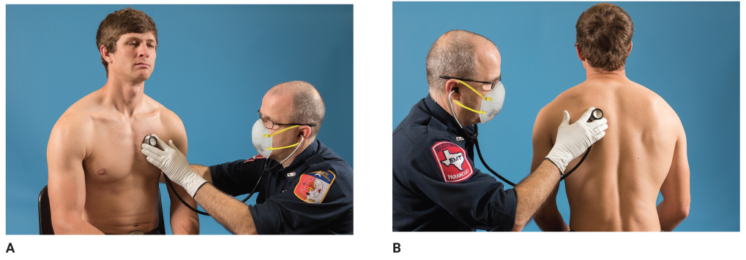
Respiratory System (6 of 7)
FIGURE 10-23 Locations for auscultating breath sounds: both sides of the chest in multiple lung fields, as shown. A. Stethoscope position for auscultating the front of the chest. B. Stethoscope position for auscultating the back.
© Jones & Bartlett Learning.
Notes:
The photos on this slide demonstrate how to listen to a patient’s breath sounds.

Slide 107
Respiratory System (7 of 7)
What are you listening for?
  Normal breath sounds
  Snoring breath sounds
  Wheezing breath sounds
  Crackles
  Rhonchi
  Stridor
Notes:
Lecture Outline
i. Auscultating breath sounds

Slide 108
Cardiovascular System (1 of 10)
Look for trauma to the chest and listen for breath sounds.
Consider the pulse, respiratory rate, and blood pressure.
Pay attention to rate, quality, and rhythm.
Notes:
Lecture Outline
5. Cardiovascular system
a. Look for trauma to the chest and listen for breath sounds.
b. Consider the pulse and respiratory rate and the blood pressure.
c. Pay particular attention to rate, quality, and rhythm.

Slide 109
Cardiovascular System (2 of 10)
Consider your findings when assessing the skin.
Check and compare distal pulses.
Consider auscultation for abnormal heart sounds.
Notes:
Lecture Outline
d. Consider your findings when assessing the skin.
e. Check and compare distal pulses to determine any right and left side differences.
f. Consider auscultation for abnormal heart sounds.

Slide 110
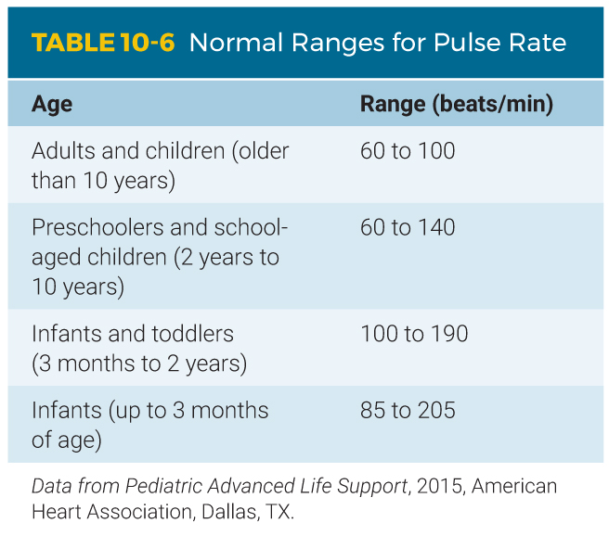
Cardiovascular System (3 of 10)
Pulse rate
  Normal resting pulse for an adult is between 60 and 100 beats/min.
  The younger the patient, the faster the pulse.
Notes:
Lecture Outline
g. Pulse rate

Slide 111
Cardiovascular System (4 of 10)
Pulse quality
  Describe a stronger than normal pulse as “bounding.”
  A pulse that is weak and difficult to feel is described as “weak” or “thready.”
Notes:
Lecture Outline
h. Pulse quality

Slide 112
Cardiovascular System (5 of 10)
Pulse rhythm
  Regular
    The interval between each contraction should be the same.
    The pulse should occur at a constant, regular rhythm.
  Irregular
    If the heart periodically has an early or late beat.
    If a pulse beat is missed.
Notes:
Lecture Outline
i. Pulse rhythm

Slide 113
Cardiovascular System (6 of 10)
Blood pressure
  Pressure of circulating blood against the walls of the arteries
  A drop in blood pressure may indicate:
    A loss of blood or fluid components
    A loss of vascular tone and sufficient arterial constriction
    A cardiac pumping problem
Notes:
Lecture Outline
j. Blood pressure

Slide 114
Cardiovascular System (7 of 10)
Blood pressure (cont’d)
  Decreased blood pressure is a late sign of shock.
  Abnormally high blood pressure may result in a rupture or other critical damage in the arterial system.
Notes:
Lecture Outline
j. Blood pressure

Slide 115
Cardiovascular System (8 of 10)
A blood pressure cuff with gauge contains the following components:
  A wide outer cuff
  An inflatable wide bladder
  A ball-pump with a one-way valve
  A pressure gauge
Notes:
Lecture Outline
A blood pressure cuff with gauge (sphygmomanometer) contains the following components:
i. A wide outer cuff
ii. An inflatable wide bladder sewn into a portion of the cuff
iii. A ball-pump with a one-way valve
iv. A pressure gauge calibrated in millimeters of mercury

Slide 116
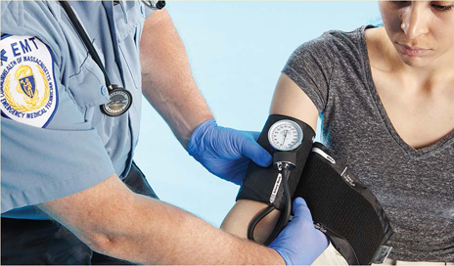
Cardiovascular System (9 of 10)
Auscultation is the most common means of measuring blood pressure.
Palpation method does not depend on the ability to hear sounds.
Follow standard precautions. Check for a dialysis
fistula, central line, previous mastectomy, and
injury to the arm. If any are present, use the
brachial artery on the other arm. Apply the cuff
snugly. The lower border of the cuff should be
about 1 inch (2.5 cm) above the antecubital space.
Notes:
Lecture Outline
l. Auscultation is the most common means of measuring a patient’s blood pressure.
i. See Skill Drill 10-3.
m. The palpation (feeling) method does not depend on your ability to hear sounds and should be used in certain cases to obtain a patient’s blood pressure.
i. See Skill Drill 10-4.

Slide 117
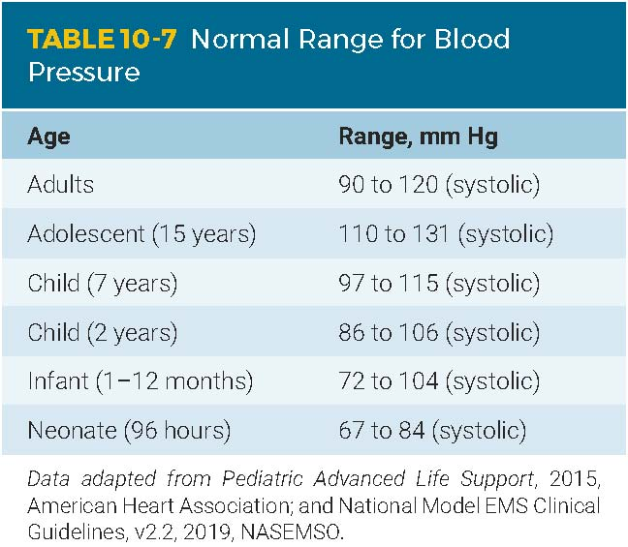
Cardiovascular System (10 of 10)
Normal blood pressure
  Hypotension: Blood pressure is
  lower than normal.
  Hypertension: Blood pressure is
  higher than normal.
Notes:
Lecture Outline
n. Normal blood pressure

Slide 118
Neurologic System (1 of 2)
Neurologic assessment
  Should be performed with any patient who has:
    Changes in mental status
    A possible head injury
    Stupor
    Dizziness/drowsiness
    Syncope
Notes:
Lecture Outline
6. Neurologic system
a. A neurologic assessment should be performed any time you are confronted with a patient who has:
i. Changes in mental status
ii. A possible head injury
iii. Stupor
iv. Dizziness
v. Drowsiness
vi. Syncope

Slide 119
Neurologic System (2 of 2)
Neurologic assessment (cont’d)
  Evaluate the level of consciousness and orientation.
  Use the AVPU scale if appropriate.
  The Glasgow Coma Scale (GCS) score can be helpful in providing additional information.
Notes:
Lecture Outline
b. Evaluate the LOC and orientation to determine the patient’s ability to think.
i. Use the AVPU scale if appropriate to determine the patient’s mental status.
c. The Glasgow Coma Scale (GCS) score can be helpful in providing additional information on patients with mental status changes.

Slide 120
Pupils (1 of 4)
The pupil is the black center portion of the eye.
  Normally round and of approximately equal size
  In the absence of any light, the pupils will become fully relaxed and dilated.
Notes:
Lecture Outline
d. Pupils
i. Normally round and of approximately equal size and adjust their size depending on the available light.
ii. The diameter and reactivity to light of the patient’s pupils can reflect the status of the brain’s perfusion, oxygenation, and condition.
iii. In the absence of light, the pupils will become fully relaxed and dilated.

Slide 121
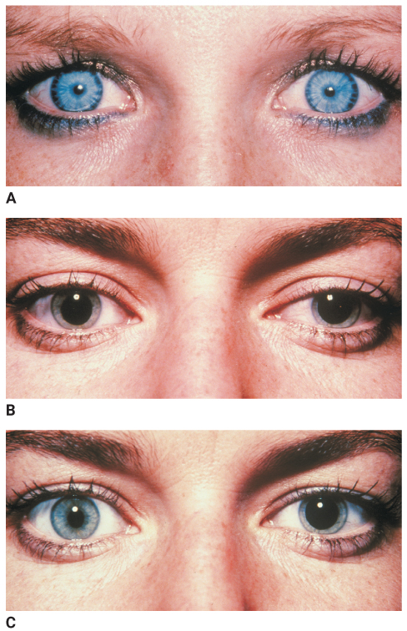
Pupils (2 of 4)
FIGURE 10-26 A. Constricted pupils. B. Dilated pupils. C. Unequal pupils.
A., B., C: © American Academy of Orthopaedic Surgeons.
Notes:
The photos on this slide show examples of constricted, dilated, and unequal pupils.

Slide 122
Pupils (3 of 4)
A small number of the population exhibit unequal pupils (anisocoria).
Causes of depressed brain function:
  Injury of the brain or brainstem
  Trauma or stroke
  Brain tumor
  Inadequate oxygenation or perfusion
  Drugs or toxins
Notes:
Lecture Outline
iv. A small number of the population exhibit unequal pupils (anisocoria).
v. Abnormal pupillary response can indicate altered brain function.

Slide 123
Pupils (4 of 4)
PEARRL is a useful assessment guide:
  Pupils
  Equal
  And
  Round
  Regular in size
  React to Light
Notes:
Lecture Outline
vi. The mnemonic PEARRL is a useful assessment guide:
(a) Pupils
(b) Equal
(c) And
(d) Round
(e) Regular in size
(f) React to Light

Slide 124
Neurovascular Status
Check for bilateral muscle strength and weakness.
Complete a thorough sensory assessment.
Test for pain, sensations, and position.
Compare distal and proximal sensory and motor responses and one side with the other.
Notes:
Lecture Outline
7. Assessing neurovascular status
a. Perform a hands-on assessment to determine sensory and motor response.
b. Check for bilateral muscle strength and weaknesses.
c. Complete a thorough sensory assessment.
d. Test for pain, sensations, and position, and compare distal and proximal sensory and motor responses and one side with the other.
e. See Skill Drill 10-5.

Slide 125
Anatomic Regions (1 of 6)
Head, neck, and cervical spine
  Palpate the scalp and skull.
  Check the patient’s eyes.
  Check the color of the sclera.
  Assess the patient’s cheekbones.
  Check the patient’s ears and nose for fluid.
Notes:
Lecture Outline
8. Anatomic regions
a. Head, neck, and cervical spine

Slide 126
Anatomic Regions (2 of 6)
Head, neck, and cervical spine (cont’d)
  Check the upper (maxillae) and lower (mandible) jaw.
  Open the patient’s mouth and look for any broken or missing teeth.
  Note any unusual odors in the mouth.
Notes:
Lecture Outline
a. Head, neck, and cervical spine.

Slide 127
Anatomic Regions (3 of 6)
Chest
  Inspect, visualize, and palpate.
  Watch for both sides of the chest to rise and fall together with normal breathing.
  Observe for abnormal breathing signs.
Notes:
Lecture Outline
b. Chest

Slide 128
Anatomic Regions (4 of 6)
Abdomen
  Palpate for tenderness, rigidity, and patient guarding.
  Four quadrants:
    Left upper quadrant (LUQ)
    Left lower quadrant (LLQ)
    Right upper quadrant (RUQ)
    Right lower quadrant (RLQ)
Notes:
Lecture Outline
c. Abdomen

Slide 129
Anatomic Regions (5 of 6)
Pelvis
  Inspect for symmetry and any obvious signs of injury, bleeding, and deformity.
Extremities
  Inspect for symmetry, cuts, bruises, swelling, obvious injuries, and bleeding.
  Palpate for deformities.
  Check for pulses and motor and sensory functions.
Notes:
Lecture Outline
d. Pelvis
e. Extremities

Slide 130
Anatomic Regions (6 of 6)
Posterior body
  Inspect the back for DCAP-BTLS, symmetry, and open wounds.
  Palpate the spine from the neck to the pelvis for tenderness and deformity.
Notes:
Lecture Outline
f. Posterior body

Slide 131
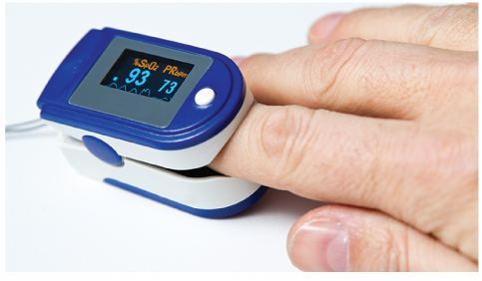
Assess Vital Signs (1 of 4)
Use appropriate monitoring devices.
  Should never replace your comprehensive assessment of the patient
Pulse oximetry
  Used to evaluate oxygenation’s effectiveness
FIGURE 10-36 The pulse oximeter is a device that measures the saturation of oxygen in the blood as a percentage.
© juanrvelasco/iStock.
Notes:
Lecture Outline
F. Assess vital signs using the appropriate monitoring device.
1. These devices should never be used to replace your comprehensive assessment of your patient.
2. Pulse oximetry

Slide 132
Assess Vital Signs (2 of 4)
Pulse oximetry (cont’d)
  Measures the oxygen saturation of hemoglobin in the capillary beds
  Patients with difficulty breathing should receive oxygen regardless of their pulse oximetry value.
Notes:
Lecture Outline
2. Pulse oximetry

Slide 133
Assess Vital Signs (3 of 4)
Capnography
  Can quickly provide information on a patient’s ventilation, circulation, and metabolism
Blood glucometry
  Measures the level of glucose in the bloodstream
Notes:
Lecture Outline
3. Capnography
4. Blood glucometry
a. See Skill Drill 10-6.

Slide 134
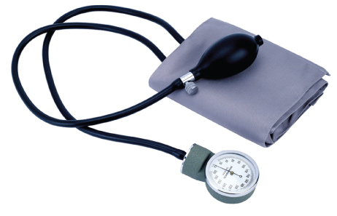
Assess Vital Signs (4 of 4)
Noninvasive blood pressure measurement
FIGURE 10-24 A sphygmomanometer.
© WizData, Inc./Shutterstock.
Notes:
Lecture Outline
5. Noninvasive blood pressure measurement

Slide 135
Reassessment (1 of 4)
Perform at regular intervals during the assessment process.
Repeat the primary assessment.
Reassess vital signs.
  Compare with the baseline vital signs obtained during the primary assessment.
  Look for trends.
Notes:
Lecture Outline
VI. Reassessment
A. Perform a reassessment at regular intervals during the assessment process.
1. The purpose of reassessment is to identify and treat changes in a patient’s condition.
B. Repeat the primary assessment.
C. Reassess vital signs.
1. Compare the baseline vitals obtained during the primary assessment with any and all subsequent vital signs.
2. Look for trends.

Slide 136
Reassessment (2 of 4)
Reassess the chief complaint.
  Ask and answer the following questions:
    Is the current treatment improving the patient’s condition?
    Has an already identified problem gotten better?
    Has an already identified problem gotten worse?
    What is the nature of any newly identified problems?
Notes:
Lecture Outline
D. Reassess the chief complaint.

Slide 137
Reassessment (3 of 4)
Recheck interventions.
  Check all interventions.
  Most important are the patient’s ABCs.
  Ensure management of bleeding.
  Ensure adequacy of other interventions, and consider the need for new interventions.
Notes:
Lecture Outline
E. Recheck interventions.

Slide 138
Reassessment (4 of 4)
Identify and treat changes in the patient’s condition.
  Document any changes, whether positive or negative.
Reassess the patient.
  Unstable patients: approximately every 5 minutes
  Stable patients: approximately every 15 minutes
Notes:
Lecture Outline
F. Identify and treat changes in the patient’s condition.

Slide 139
Review
During the scene size-up, you should routinely determine all of the following, EXCEPT:
  the mechanism of injury or nature of illness.
  the ratio of pediatric patients to adult patients.
  whether or not additional resources are needed.
  if there are any hazards that will jeopardize safety.

Slide 140
Review
Answer: B
Rationale: Components of the scene size-up—after taking standard precautions—include determining if the scene is safe for entry, determining the mechanism of injury or nature of illness, determining the number of patients, and determining if additional resources are needed at the scene.

Slide 141
Review
During the scene size-up, you should routinely determine all of the following, EXCEPT:
  the mechanism of injury or nature of illness.
  Rationale: This is part of the scene size-up.
  the ratio of pediatric patients to adult patients.
  Rationale: Correct answer
  whether or not additional resources are needed.
  Rationale: This is part of the scene size-up.
  if there are any hazards that will jeopardize safety.
  Rationale: This is part of the scene size-up.

Slide 142
Review
You arrive at the scene of an “injured person.” As you exit the ambulance, you see a man lying on the front porch of his house. He appears to have been shot in the head and is lying in a pool of blood. You should:
  immediately assess the patient.
  proceed to the patient with caution.
  quickly assess the scene for a gun.
  retreat to a safe place and wait for law enforcement to arrive.

Slide 143
Review
Answer: D
Rationale: Your primary responsibility as an EMT is to protect yourself. Prior to entering any scene, you must assess for potential dangers. In cases where violence has occurred, you must retreat to a safe place and wait for law enforcement personnel to arrive.

Slide 144
Review
You arrive at the scene of an “injured person.” As you exit the ambulance, you see a man lying on the front porch of his house. He appears to have been shot in the head and is lying in a pool of blood. You should:
  immediately assess the patient.
  Rationale: You must wait until the scene is safe.
  proceed to the patient with caution.
  Rationale: You must wait until the scene is safe.
  quickly assess the scene for a gun.
  Rationale: This is the responsibility of law enforcement.
  retreat to a safe place and wait for law enforcement to arrive.
  Rationale: Correct answer

Slide 145
Review
Findings such as inadequate breathing or an altered level of consciousness should be identified in the:
  primary assessment.
  focused assessment.
  secondary assessment.
  reassessment.

Slide 146
Review
Answer: A
Rationale: The purpose of the primary assessment is to identify and manage any life threats to the patient, such as inadequate breathing, an altered level of consciousness, or severe hemorrhage.

Slide 147
Review
Findings such as inadequate breathing or an altered level of consciousness should be identified in the:
  primary assessment.
  Rationale: Correct answer
  focused assessment.
  Rationale: The focused assessment takes place during the secondary assessment, if appropriate.
  secondary assessment.
  Rationale: The purpose of the secondary assessment is to perform a systematic physical examination of the patient after the primary assessment.
  reassessment.
  Rationale: Reassessment is performed to identify and treat changes in a patient’s condition after the primary assessment.

Slide 148
Review
Which of the following would you NOT detect while determining your initial general impression of a patient?
  Cyanosis
  Gurgling respirations
  Severe bleeding
  Rapid heart rate

Slide 149
Review
Answer: D
Rationale: The initial general impression is what you first notice as you approach the patient, but before physical contact with the patient is made. It is what you see, hear, or smell. A rapid heart rate (tachycardia) would not be detected until you actually perform the entire primary assessment; you cannot see, hear, or smell tachycardia.

Slide 150
Review
Which of the following would you NOT detect while determining your initial general impression of a patient?
  Cyanosis
  Rationale: You can see cyanosis while determining your initial general impression.
  Gurgling respirations
  Rationale: You can hear gurgling while determining your initial general impression.
  Severe bleeding
  Rationale: You can see bleeding while determining your initial general impression.
  Rapid heart rate
  Rationale: Correct answer

Slide 151
Review
Your primary assessment of an elderly woman who fell reveals an altered level of consciousness and a large hematoma to her forehead. After protecting her spine and administering oxygen, you should:
  reassess your interventions.
  perform a rapid exam.
  transport the patient immediately.
  perform a focused assessment of her head.

Slide 152
Review
Answer: B
Rationale: If any life-threatening problems are discovered in the primary assessment, they should be addressed immediately. The EMT should then perform a rapid exam to look for other potentially life-threatening injuries or conditions.

Slide 153
Review
Your primary assessment of an elderly woman who fell reveals an altered level of consciousness and a large hematoma to her forehead. After protecting her spine and administering oxygen, you should:
  reassess your interventions.
  Rationale: This is the last step of the patient assessment process.
  perform a rapid exam.
  Rationale: Correct answer
  transport the patient immediately.
  Rationale: This is determined after the completion of a rapid exam.
  perform a focused assessment of her head.
  Rationale: This performed during the secondary assessment.

Slide 154
Review
A semiconscious patient pushes your hand away when you pinch his earlobe. You should describe his level of consciousness as:
  alert.
  unresponsive.
  responsive to painful stimuli.
  responsive to verbal stimuli.

Slide 155
Review
Answer: C
Rationale: Semiconscious patients are not alert, nor are they unresponsive. The fact that the patient pushes your hand away when you pinch his earlobe indicates that he is responsive to painful stimuli. If he opens his eyes or responds when you speak to him, he would be described as being responsive to verbal stimuli.

Slide 156
Review
A semiconscious patient pushes your hand away when you pinch his earlobe. You should describe his level of consciousness as:
  alert.
  Rationale: This is when the patient’s eyes open spontaneously as you approach.
  unresponsive.
  Rationale: This is when the patient does not respond to any stimulus.
  responsive to painful stimuli.
  Rationale: Correct answer
  responsive to verbal stimuli.
  Rationale: This is when the patient’s eyes open with verbal stimuli and he or she tries to respond.

Slide 157
Review
Assessment of an unconscious patient’s breathing begins by:
  inserting an oral airway.
  manually positioning the head.
  assessing respiratory rate and depth.
  clearing the mouth with suction as needed.

Slide 158
Review
Answer: B
Rationale: You cannot assess or treat an unconscious patient’s breathing until the airway is patent—that is, open and free of obstructions. Manually open the patient’s airway (eg, head tilt–chin lift, jaw-thrust), use suction as needed to clear the airway of blood or other liquids, insert an airway adjunct to assist in maintaining airway patency, and then assess the patient’s respiratory effort.

Slide 159
Review
Assessment of an unconscious patient’s breathing begins by:
  inserting an oral airway.
  Rationale: You insert an airway adjunct to assist in maintaining airway patency after the head tilt–chin lift.
  manually positioning the head.
  Rationale: Correct answer
  assessing respiratory rate and depth.
  Rationale: After the airway is opened and suctioned, then determine the patient’s respiratory effort by assessing the respiratory rate and depth.
  clearing the mouth with suction as needed.
  Rationale: This is done after attempting to open the airway with proper positioning.

Slide 160
Review
Your 12-year-old patient can speak only two or three words without pausing to take a breath. He has a serious breathing problem known as:
  nasal flaring.
  two- to three-word dyspnea.
  labored breathing.
  shallow respirations.

Slide 161
Review
Answer: B
Rationale: Two- to three-word dyspnea is a severe breathing problem in which a patient can speak only two to three words at a time without pausing to take a breath.

Slide 162
Review
Your 12-year-old patient can speak only two or three words without pausing to take a breath. He has a serious breathing problem known as:
  nasal flaring.
  Rationale: Nasal flaring is the flaring out of the nostrils.
  two- to three-word dyspnea.
  Rationale: Correct answer
  labored breathing.
  Rationale: Labored breathing requires increased effort and is characterized by increased effort and depth of each respiration.
  shallow respirations.
  Rationale: Shallow respirations are characterized by little movement of the chest wall or poor chest excursion.

Slide 163
Review
How should you determine the pulse in an unresponsive 8-year-old patient?
  Palpate the radial pulse at the wrist.
  Palpate the brachial pulse inside the upper arm.
  Palpate the radial pulse with your thumb.
  Palpate the carotid pulse in the neck.

Slide 164
Review
Answer: D
Rationale: In unresponsive patients older than 1 year, you should palpate the carotid pulse in the neck. If you cannot palpate a pulse in an unresponsive patient, begin CPR.

Slide 165
Review
How should you determine the pulse in an unresponsive 8-year-old patient?
  Palpate the radial pulse at the wrist.
  Rationale: Only palpate here in responsive patients who are older than 1 year.
  Palpate the brachial pulse inside the upper arm.
  Rationale: Only palpate here in children younger than 1 year because the radial and carotid pulses are difficult to locate.
  Palpate the radial pulse with your thumb.
  Rationale: Do not palpate a pulse with your thumb. You may mistake the strong pulsing circulation in your thumb for the patient’s pulse.
  Palpate the carotid pulse in the neck.
  Rationale: Correct answer

Slide 166
Review
When assessing your patient’s pain, he says it started in his chest but has spread to his legs. This is an example of what part of the OPQRST mnemonic?
  Onset
  Quality
  Region/radiation
  Severity

Slide 167
Review
Answer: C
Rationale: The region/radiation section of the OPQRST mnemonic assesses a patient’s pain—where it hurts and where the pain has spread. Because the patient informed you that his pain spread from his chest to his legs, this would be an example of radiation.

Slide 168
Review
When assessing your patient’s pain, he says it started in his chest but has spread to his legs. This is an example of what part of the OPQRST mnemonic?
  Onset
  Rationale: This assesses the cause of the pain and when it began.
  Quality
  Rationale: This assesses the patient’s description of the pain.
  Region/radiation
  Rationale: Correct answer
  Severity
  Rationale: This assesses the severity of the patient’s pain.

